Slide 1


Slide 2
Subqueries
Putting queries in your queries

Slide 3
SQL - Last Lecture: The Select Statement
General form is SELECT <exprs> FROM <tables> WHERE <predicates>
Today we are going to talk about Subqueries (aka Sub-Selects)
Select expressions in your Select statement, for fun and for profit

Slide 4
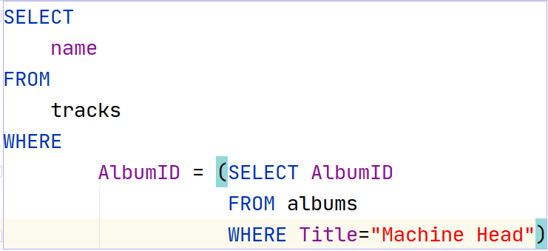
Basic Subqueries
A Subquery is a query inside another query
Allows you to base the results of one query on the results of another
A simple example
Notes:
Can be found online… but I can’t link to it

Slide 5
Basic Subqueries
Give me the name of all tracks whose AlbumID is the same as the AlbumID of the album with the title “Machine Head”
Notes:
Can be found online… but I can’t link to it

Slide 6
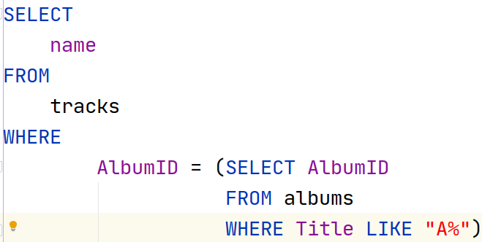
Basic Subqueries
What if we wanted the names of tracks that are on albums whose title starts with “A”?
Let’s use a LIKE...
Notes:
Can be found online… but I can’t link to it

Slide 7
Subqueries
Seems legit…
But it’s wrong
Since we are using the = operator, SQLite assumes a single value is returned
Notes:
Can be found online… but I can’t link to it

Slide 8
Subqueries
Give me the name of all tracks on the FIRST album whose name starts with “A”
Notes:
Can be found online… but I can’t link to it

Slide 9
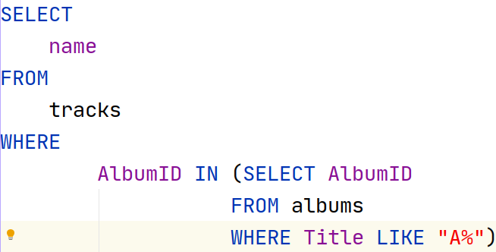
Subqueries
To do what we want, we need to switch this to an IN operator
Now we are getting the correct answer for Give me the name all tracks on albums that start with an “A”
Notes:
Can be found online… but I can’t link to it

Slide 10
Subqueries & Joins
This subquery example is closely related to a concept of JOINs
JOINs correlate tables via Foreign Keys
We will discuss Joins in the next lecture
Notes:
Can be found online… but I can’t link to it

Slide 11
Correlated Subqueries
So far we have looked at subqueries that are independent of the outer query
The outer query depends on the inner query, but not vice versa
Is it possible for the inner query to depend on the outer?
Notes:
Can be found online… but I can’t link to it

Slide 12
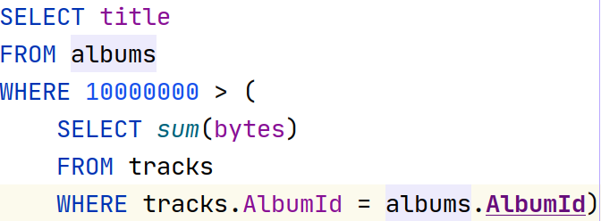
Correlated Subqueries
Yes! It certainly is!
Here is an example
Note that the outer query albums is referenced in the inner query selecting tracks
The sum() function is used to compute the total number of bytes of all the tracks
More on sum() later...
Notes:
Can be found online… but I can’t link to it

Slide 13
Correlated Subqueries
What is this saying? Show me all titles of albums whose tracks size sum to less than 1M bytes
Notes:
Can be found online… but I can’t link to it

Slide 14
Correlated Subqueries
Pretty cool!
But there is a catch…
This approach causes N + 1 queries:
1 query to select all album rows
N queries to select all tracks per album
Performance issue!
How can we get around it?
Denormalize the album size
Move condition into subquery
Notes:
Can be found online… but I can’t link to it

Slide 15
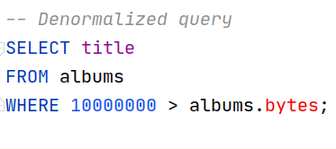
Correlated Subqueries
Denormalize the data into the album table
Pros?
Cons?
Notes:
Can be found online… but I can’t link to it

Slide 16
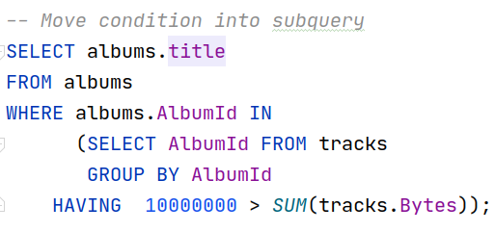
Correlated Subqueries
Move condition into the subquery using a GROUP BY statement
More on GROUP BY in a few lectures
This eliminates the correlation and makes it a 2 query job
Notes:
Can be found online… but I can’t link to it

Slide 17
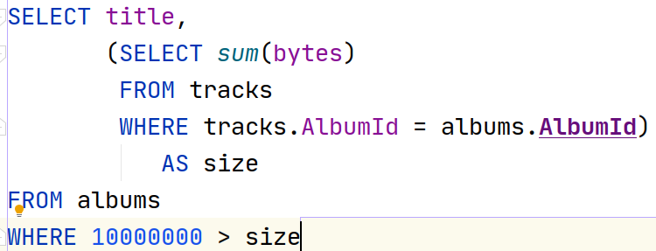
Correlated Subqueries
Where else can we use a correlated subquery?
In the select criterion!
Note that we can refer to the synthetic column in the where clause
Pretty advanced stuff...
Notes:
Can be found online… but I can’t link to it

Slide 18
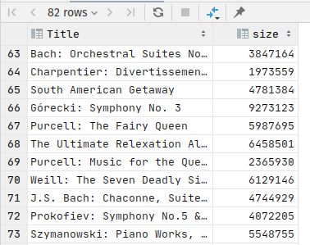
Correlated Subqueries
And cool! Now we can see the size of the album in the results…
Unfortunately this doesn’t address the performance issues
Notes:
Can be found online… but I can’t link to it

Slide 19
Correlated Subqueries
Where else can you use correlated subqueries?
Pretty much anywhere
Using them in the WHERE and SELECT clauses are the most common
Notes:
Can be found online… but I can’t link to it

Slide 20
Subqueries Summary
A SELECT within a SELECT
Independent Subqueries
Usually involve an IN expression
Closely related to JOINs
Somewhat rare but very useful in real world applications
Correlated Subqueries
The inner query refers to the outer queries data
Very powerful!
Performance issues (N+1) queries
Limited use in real world applications because of this

